Slide 1


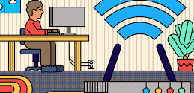

CNS PROJECT
TEAM MEMBERS:​
S.J SUMANTH(2010030377)​
E. SHIVA GOUD(2010030542)​

Slide 2


IPSEC BASED Virtual private network FOR A COMPANY

Slide 3
Outline:
Introduction
Code
Work In Progress
Git Hub Commits
Beta Testing

Slide 4

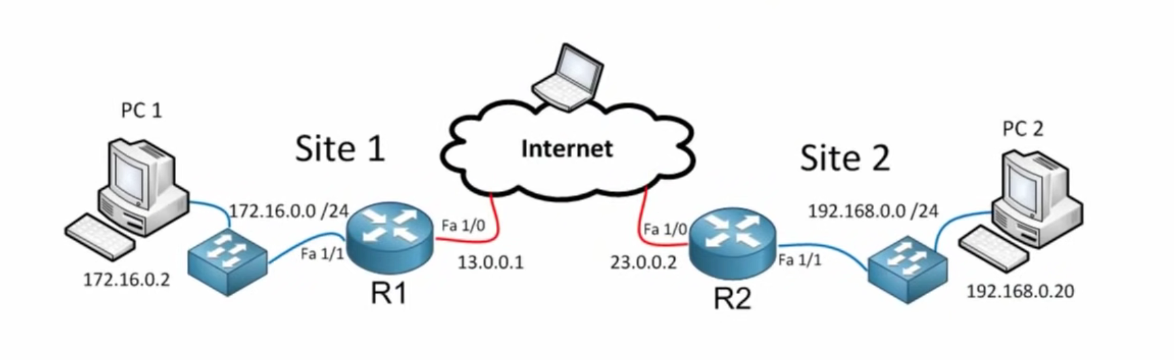
Introduction
Nowadays, organization do all they can to maintain control and help protect their corporate networks and its information asset from cyber threats. However, they heavily rely on the users as the first line of defense who sometimes are not compliance to network security regulations enacted. Therefore, it is vital for the company to ensure cybersecurity awareness and possibly security implications that can emanate from cyberattacks such as malware and network intrusions.
In addition to existing policy and network security mechanism and services, an IPsec VPN has been proposed as one of the most fundamental data security practices to ensure data privacy and protect systems effectively.
IPsec VPN authenticates and encrypt the virtual connections between two nodes. The use of IPsec protocols to implement VPN can help to protect against system vulnerabilities such as IP spoofing, session hijacking, traffic sniffing. Therefore, implementing security controls to provide confidentiality, integrity and availability.

Slide 5

Code

Slide 6
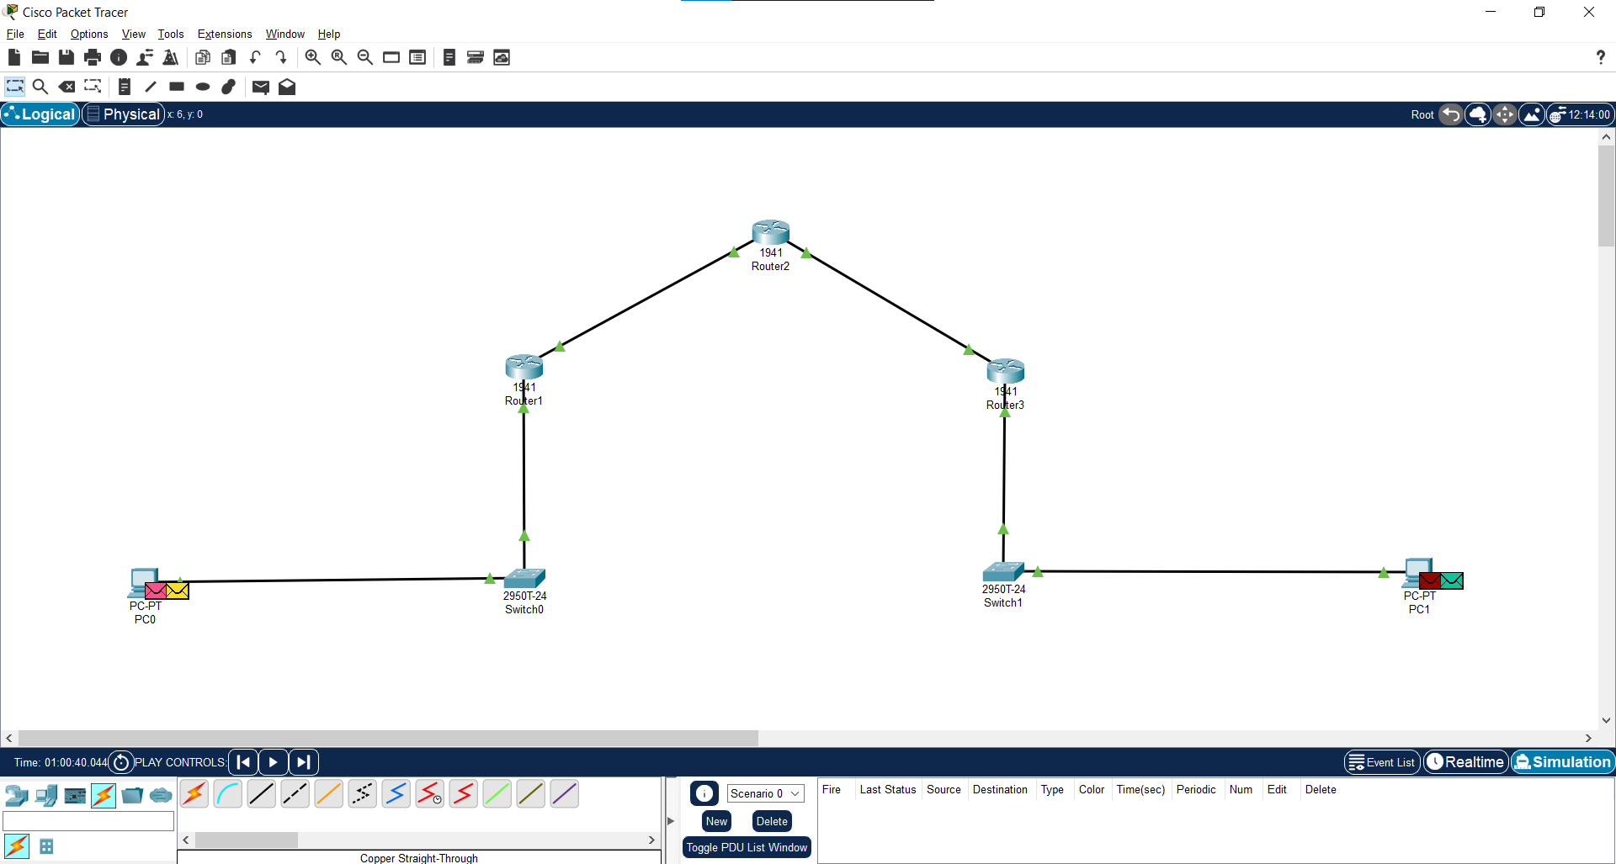

Slide 7
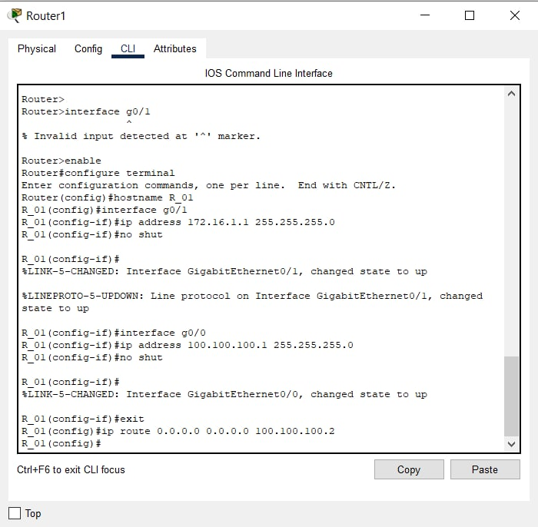
Setting up Routers

Slide 8
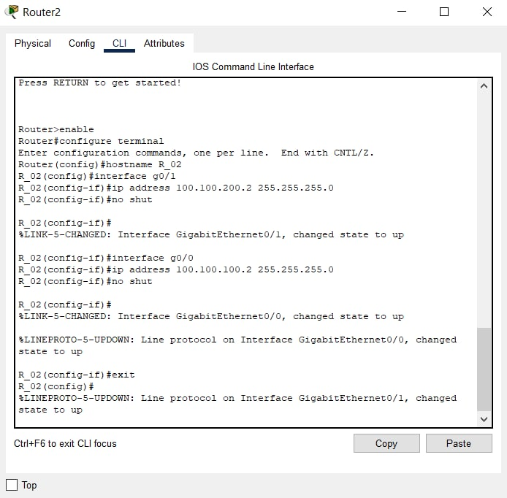
Setting up Routers

Slide 9
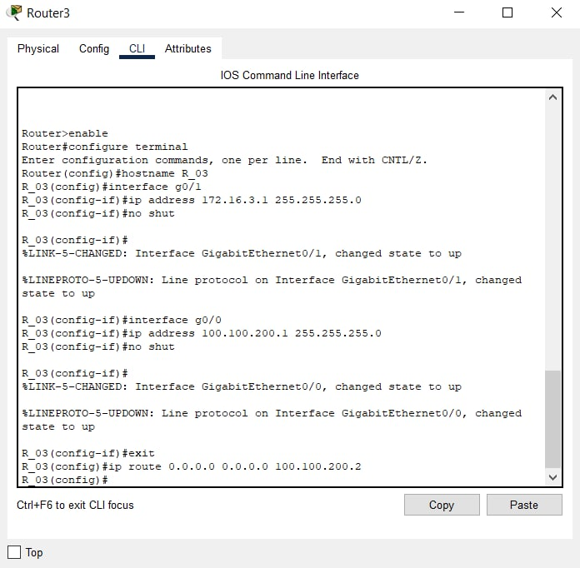
Setting up Routers

Slide 10
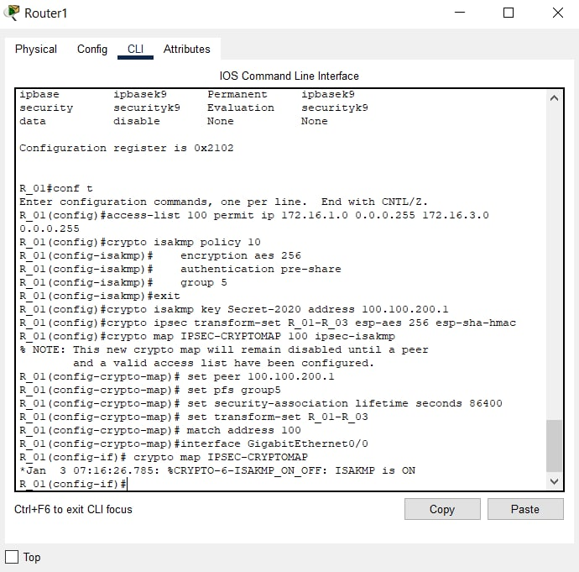
Configuring IPSEC Tunnel

Slide 11
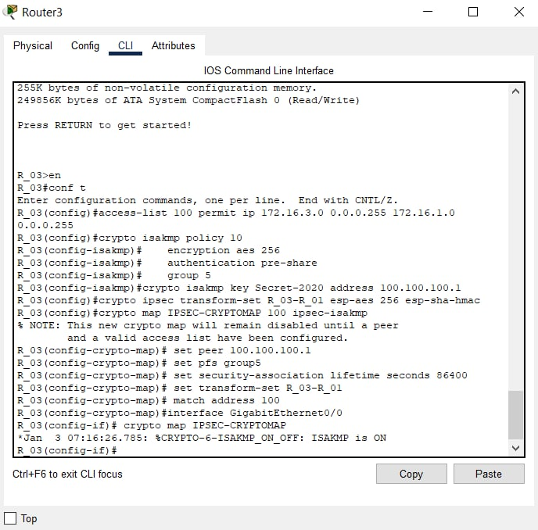
Configuring IPSEC Tunnel

Slide 12
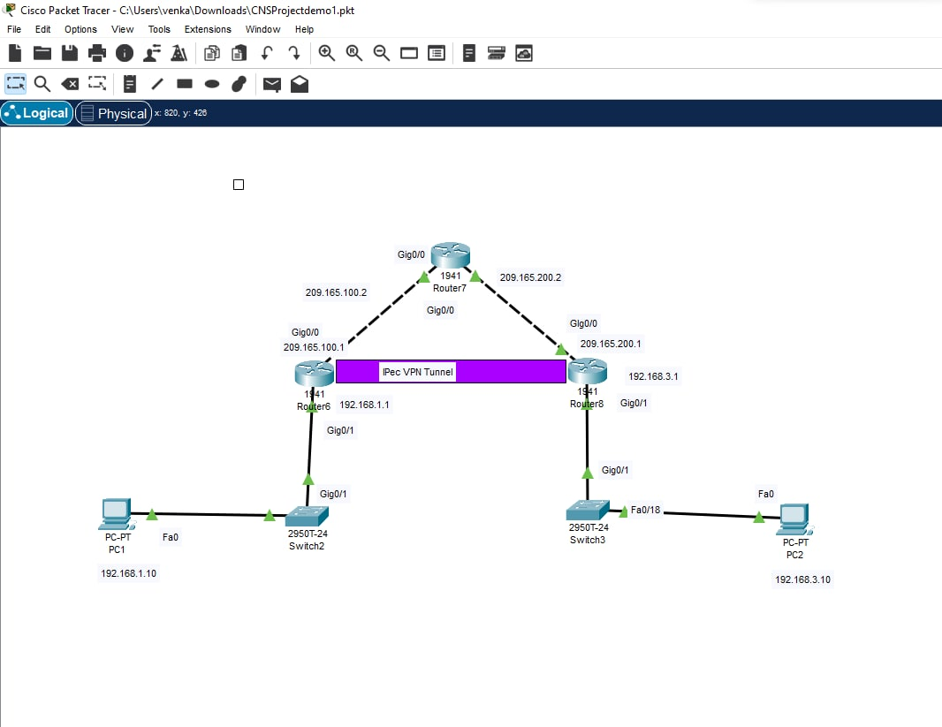

Slide 13

Work in Progress

Slide 14
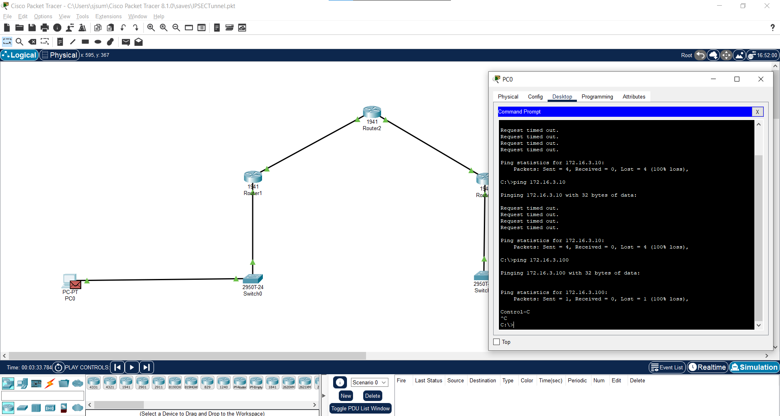

Slide 15
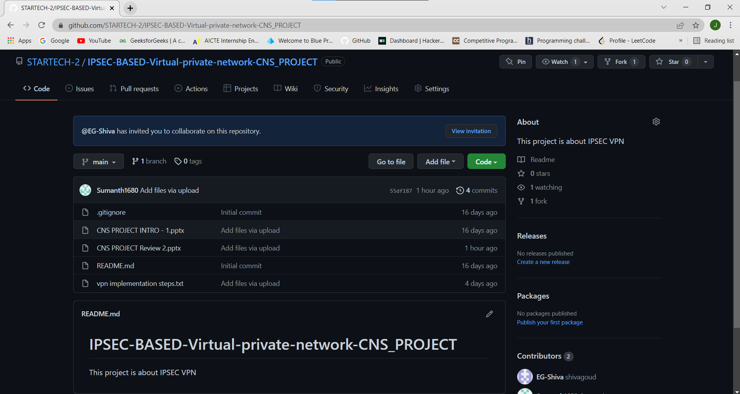
GIT HUB COMMITS

Slide 16
Beta Testing

Slide 17
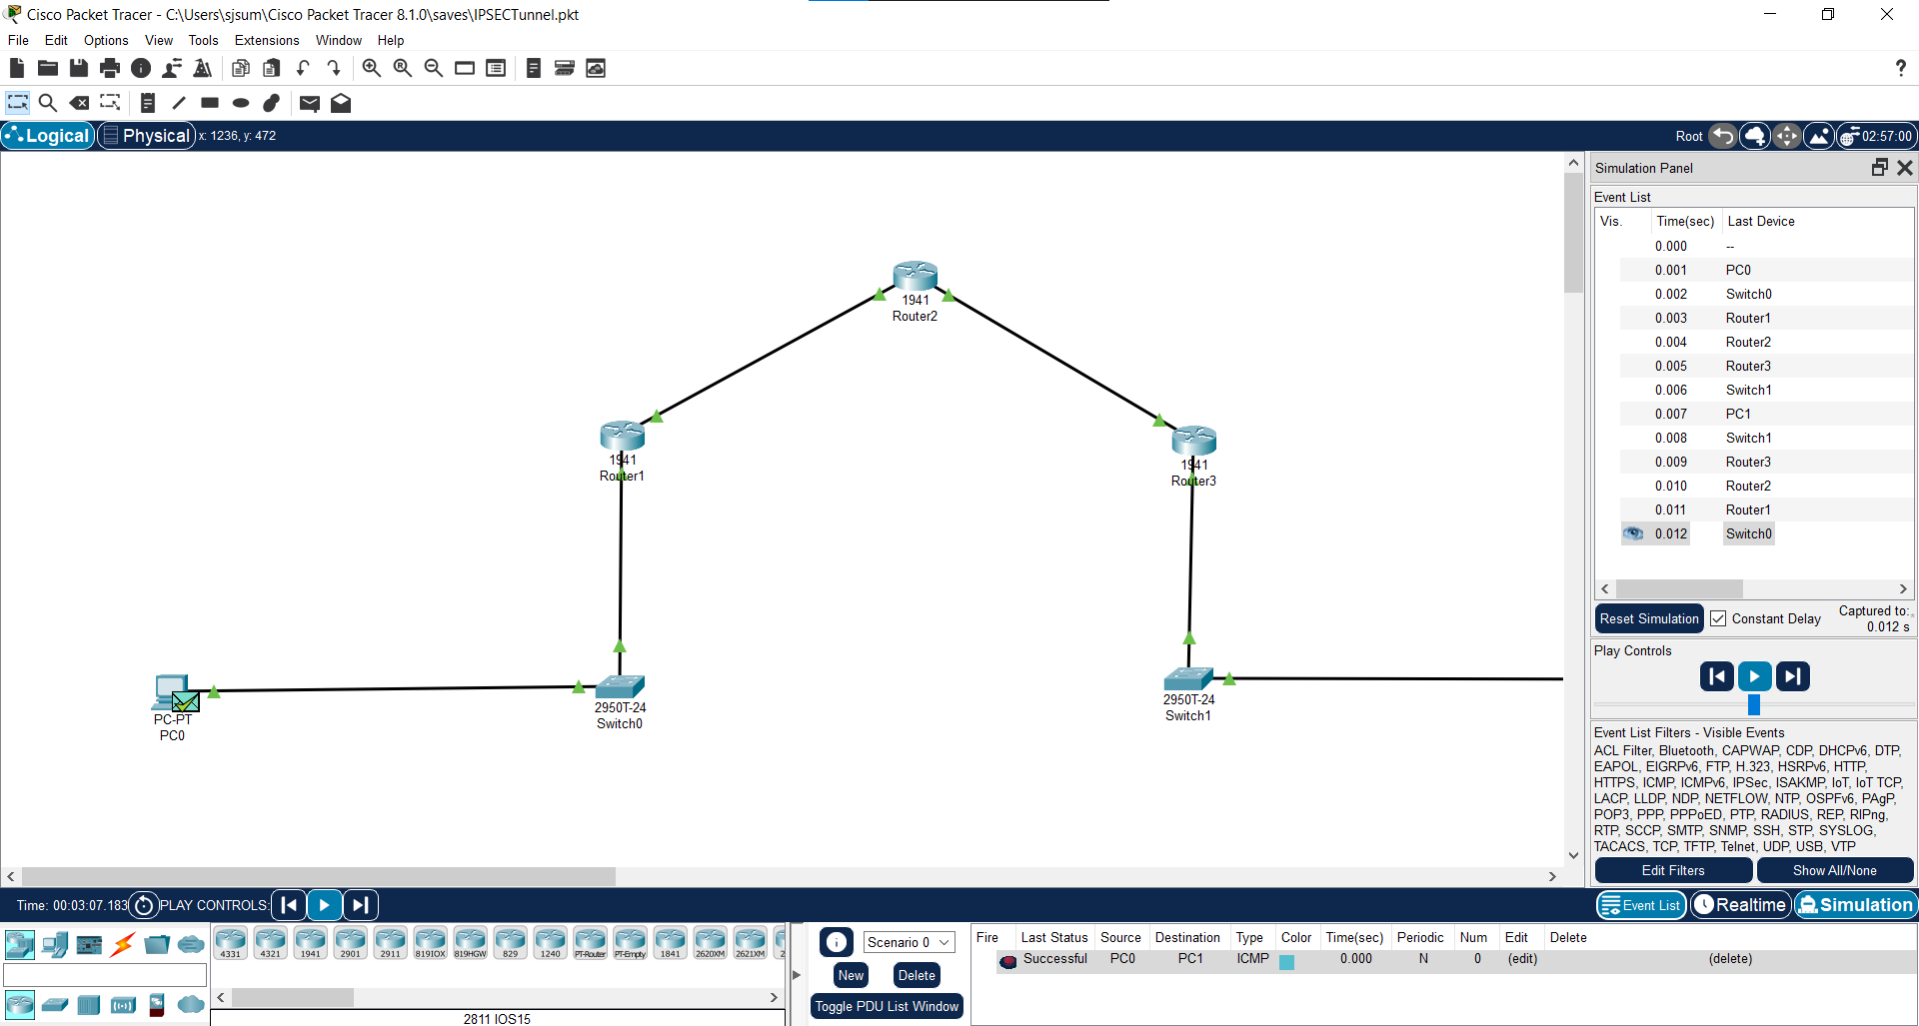

Slide 18


